Slide 1
AP Government
Unit 4: Political Institutions
Chapter 14 | 25 slides

Slide 2
Sources of American Law
Common law: judge-made law that originated in England from decisions shaped according to custom; these decisions were applied to similar situations and gradually became common to the nation.
Generally, countries that were once British colonies have adopted a common law system.
“The body of American law includes the federal and state constitutions, statutes passed by legislative bodies, administrative law, and case law—the legal principles expressed in court decisions.”
Precedent: a court ruling that has bearing on subsequent legal decisions in similar cases.
Stare decisis: judicial policy of following precedents; “to stand on decided cases.”

Slide 3
American Law
Constitutions
Sets the general organization, powers, and limits of government.
Reconciles state and federal powers; a law that is unconstitutional cannot be enforced.
Statutes & Administrative Regulations
State and federal civil and criminal laws.
Increasingly important in defining the rights and obligations of individuals.
Federal statutes = anything “that is a concern of the federal government”.

Slide 4
American Law
Case Law
Judicial interpretations of common law principles and doctrines as well as constitutional law, statutory law, and administrative law.
This is how the courts may establish law: “It is up to the courts…to decide what a constitutional provision or statutory phrase means.”
Judicial Review
The process for deciding whether a law is contrary to the Constitution.
Established in Marbury v. Madison.
Power of the Supreme Court (more than anyone else) to rule things unconstitutional, and in turn “effectively define separation of powers.”

Slide 5
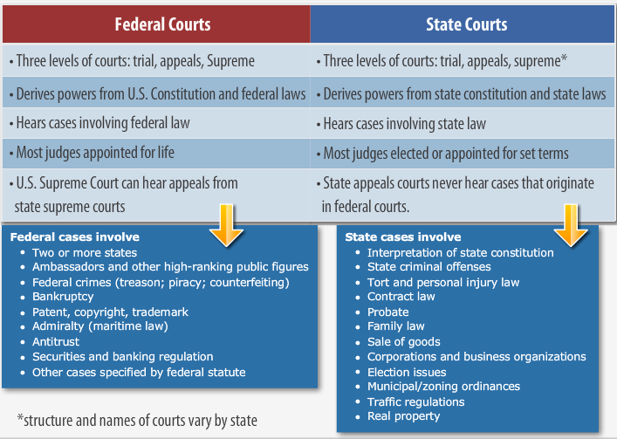
American Court System

Slide 6
Basic Judicial Requirements
Jurisdiction: the authority of a court to decide certain cases.
A court must have the ability to make decisions on cases.
Federal question: a question that has to do with the US Constitution, acts of Congress, or treaties that provides a basis for federal jurisdiction.
Diversity of citizenship: condition in which the different parties of a lawsuit are citizens of different states, a US state and citizens, or the government, which can also provide the basis for federal jurisdiction.
Standing to Sue: the justification of bringing a case before the court.
Justiciable controversy: the party bringing the lawsuit has suffered real and substantial harm or threat of harm, as opposed to hypothetical or academic.
Maintain objectivity.

Slide 7
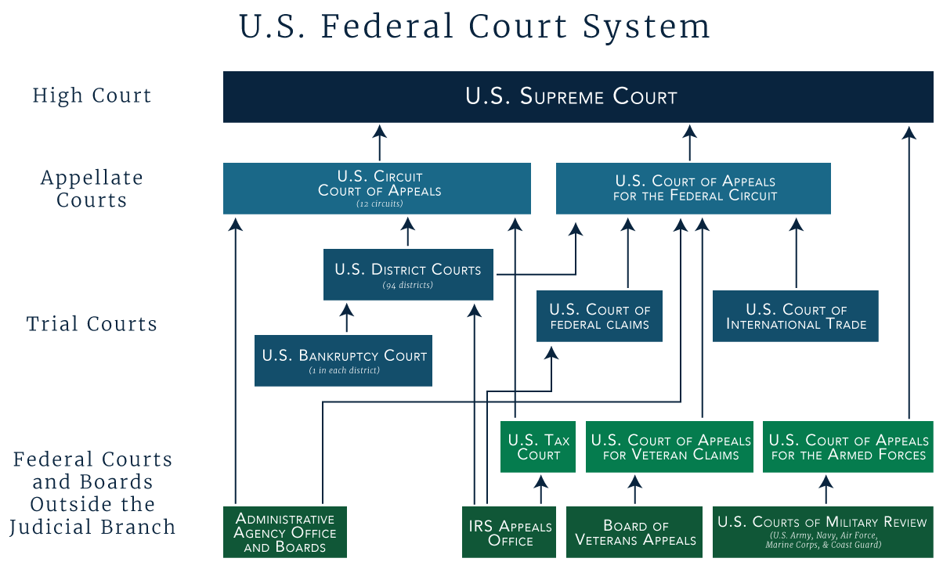
Types of Federal Courts

Slide 8
Types of Federal Courts
Three-tiered system
US district and specialized (ltd jurisdiction) courts
Intermediate courts of appeals
US Supreme Court
The military has its own court system, which may also send cases to the Supreme Court (though this doesn’t happen often).

Slide 9
US District Courts
Trial courts: the court in which most cases begin.
General jurisdiction: exists when a court’s authority to hear cases is not significantly restricted and can therefore hear a broad range of cases.
Most federal cases start here.
Every state has at least one federal district court.
Currently, there are 94 federal judicial districts.

Slide 10
Specialized Courts
Limited jurisdiction: exists when a court’s authority to hear cases is restricted to certain types of claims, such as tax claims or bankruptcy petitions.

Slide 11
US Courts of Appeals
Appellate court: a court having the jurisdiction to review cases and issues that were originally tried in lower courts.
If a defendant is not happy with the district court’s ruling, they may petition for appeal here.
There are 13 US courts of appeals; 12 hear appeals from district courts, and the remaining one is specialized to cases in which the government is a defendant.
These courts do not conduct another trial, but establish a panel to review the initial proceeding and question of law.
“An appellate court will challenge a trial court’s finding of fact when the finding is clearly contrary to the evidence presented at trial or when no evidence supports the finding.”

Slide 12
The Supreme Court
Established by Article III of the US Constitution.
Has both original and appellate jurisdiction.
This means the Supreme Court can act as a trial court and an appellate court.
Under the Court’s original jurisdiction: cases affecting foreign diplomats, cases in which a state is a party, treason.
The SC can review a state supreme court decision if a federal question is involved.
It is unlikely that petitions for appeal in the Supreme Court will be heard.

Slide 13
Notes on Your Own
Using pages 497-500, answer the following questions to include in your notes for this chapter. It will be helpful to copy down the questions.
What is the FISA court and what does it do? How is its process different from the basic legal process?
What is an Alien Removal Court and what does it do? How is its process different from the basic legal process?
What would these courts classify as, district, specialized, appellate? Why?
What has the Supreme Court said in regard to Alien Removal Courts?
Define the following terms: plaintiff, defendant, litigate, class-action suit.
How and why are interest groups becoming more involved in court cases?
Why do procedural rules exist?
Compare civil contempt with criminal contempt.

Slide 14
The Supreme Court
Term October-June/July, with cases able to be carried over.
Responsible for .5% (that’s point-five%) of all cases, though their decisions have the ability to affect the entire country.
Most of its work is appellate and “it can influence the nation’s policies both by issuing decisions in some types of cases and refusing to hear appeals in others.”
Their jurisdiction is entirely discretionary—they don’t have to hear all cases petitioned to them.

Slide 15
The Supreme Court
Rule of Four: the decision to hear a case must be agreed to by four of the nine justices.
Whether a legal question has been decided differently by different lower courts.
Whether a lower court’s decision conflicts with SC precedent.
Whether the issue involved could have significance beyond those directly involved.
Whether the solicitor general is pressuring the Court to be involved on behalf of the federal government.
Writ of Certiorari: order from the SC to lower court to send files for review.

Slide 16
The Supreme Court
Deciding Cases
Court does review and research
Oral arguments are permitted, but mainly for purpose of the Court asking questions.
Proceedings are recording.
Justices in secret conference to vote on decision.

Slide 17
The Supreme Court
Opinions of the Court
Unanimous: the whole Court feels the same way about the case.
Majority: a majority of the Court feels the same way about the case.
Concurring: an opinion that agrees with the majority but for different reasons.
Issued separately from the majority.
Dissenting: disagrees with the majority for their own reasons.
Issued separately from the majoring, concurring.

Slide 18
The Supreme Court
Other actions:
The SC may choose to affirm the initial court’s decision; this declares the initial ruling valid.
The SC may reverse the initial court’s decision; this would void the ruling on an error or irregularity
The SC may remand the case, sending it back to the initial court for retrial or other proceedings.
Per curiam opinion: unsigned opinion of the court on a case—petition was not granted, but the SC puts its 2 cents in anyway.

Slide 19
Judicial Appointments
All federal judges are appointed as per the Constitution.
Decided by the president with the advice and consent of the Senate.
Senate Judiciary Committee invites testimony and will most likely conduct an interview, before voting to approve or veto appointment.
Senatorial courtesy: a tradition of allowing a senator to veto a judicial appointment to their state, typically seen with district courts.

Slide 20
Judicial Appointments
There are NO constitutional requirements for the Supreme Court.
Article 3, Section 1: Let there be courts!
Article 3, Section 2: Here’s what jurisdiction is/does/exists where.
Article 3, Section 3: Treason.
However, most have been lawyers and judges previous to being nominated.
It makes sense that if you’re going to interpret the law at this level, you have some experience with it.

Slide 21
Judicial Appointments
The president will most likely appoint someone from their own party, or who identifies with the ideals of that party.
This is a way to institutionalize their ideas, or keep those ideas, within government after their time as president is over.
Because of this, the Supreme Court often leans conservative or liberal, depending on how many appointments the president can make there.
A judge or Justice may serve for life (meaning voluntary retirement or death, whichever comes first).
Because politics has become so polarized in recent years, it has become extremely difficult for a president to appoint a SC Justice if their party does not control the Senate.
Regular judgeships have followed suit because judge-made law in the effort of social change can provoke political reactions.

Slide 22
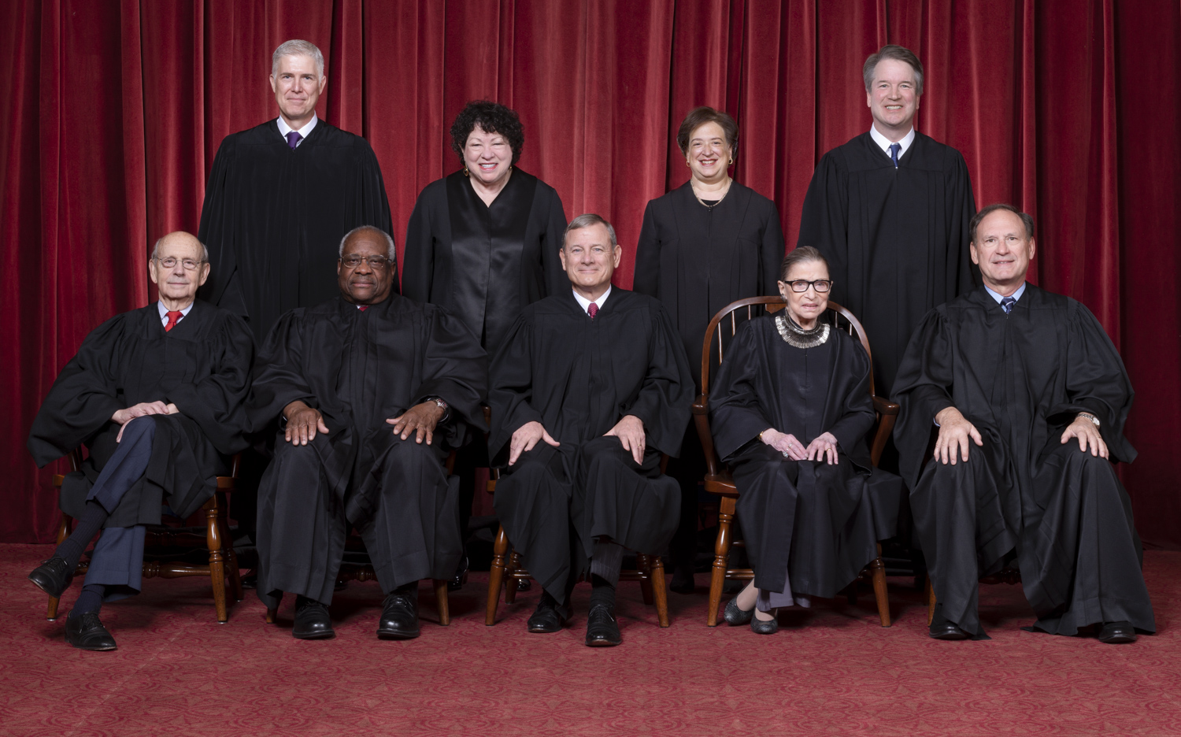
The Supreme Court
Name | Appointed in | Appointed by | Current Age
Chief Justice John Roberts | 2005 | George W. Bush | 65
Clarence Thomas | 1991 | George H.W. Bush | 71
Ruth Bader Ginsburg | 1993 | Bill Clinton | 86
Stephen Breyer | 1994 | Bill Clinton | 81
Samuel Alito | 2006 | George W. Bush | 69
Sonia Sotomayor | 2009 | Barack Obama | 65
Elena Kagan | 2010 | Barack Obama | 59
Neil M. Gorsuch | 2017 | Donald Trump | 52
Brett Kavanaugh | 2018 | Donald Trump | 54

Slide 23
Policymaking
Judicial review: when used by the SC, can invalidate laws across the country.
A staple of checks and balances, or too much power? You decide.
Judicial activism: when the SC makes a decision that promotes societal change, holding the other branches of government in check as they have exceeded their authority.
Ex: Brown v. Board, Texas v. Johnson
Judicial restraint: when the SC makes a decision that does not promote change and instead defers to the “elected judgement” of Congress and the president
McCulloch v. Maryland, Schenck v. US
Constructionism: influences individual interpretation and therefor use of judicial review.

Slide 24
Checks on the Court
Executive Checks
Judicial implementation: the way in which court decisions are translated into action and their subsequent enforcement.
Appointment power
Use of military power (rare)
Legislative Checks
Constitutional amendments
Rewriting or amending laws to ensure correct interpretation and implementation
Public Opinion or Pressure

Slide 25
Checks on the Court
Judicial Traditions and Doctrines
Narrowing focus rather than make a sweeping decision
Stare decisis and established precedents
Hypothetical & political questions vs. justiciable questions
The issue in the case has to be real, with the ability to be answered by a court.
Political question: an issue that a court believes is better left to elected officials.

