Slide 1
AP Government
Unit 1: Foundations of Government
Chapter 2 | 29 slides

Slide 2
British Government
Two major concepts permeate through the evolution of British government to American government: limited gov’t and representative gov’t.
The first permanent British settlements appear in the early 1600s.
Jamestown creates a representative assembly to make laws while representing the population.
Separatists in Plymouth created the Mayflower Compact to ensure the continuance of civil government.
Both set examples for the future:
The Jamestown government allowed for direct participation.
The Mayflower Compact was dependent on the consent of those it would effect.

Slide 3
Influential Events & Documents
1215: Magna Carta
Declared the power of the monarch limited, providing protection against the loss of life, liberty, and property except in accordance to the law.
Contains the important Writ of Habeas Corpus
1628: Petition of Right
Signed after a fallout between King Charles I and Parliament in order to limit the power in favor of the subjected.
It backs up the Magna Carta, and sets clearer limits on things like taxes and martial law.

Slide 4
Influential Events & Documents
1688: Glorious Revolution
The first peaceful transition of power and last successful invasion of Britain.
Ended the scandal-ridden reign of James I in favor of William and Mary.
1689: English Bill of Rights
Provided clear limits on what a monarch could or could not do incorporating key ideas from the other documents, laws, and experience.
Things listed in the English Bill of Rights extended out to the colonies.

Slide 5
The English Bill of Rights
Monarchs do not have divine rule. They rule by the consent of the people’s representatives in Parliament.
Monarchs must have Parliament’s consent to suspend laws, levy taxes, and/or maintain a (private) army.
Monarchs cannot interfere with parliamentary elections and debates.
The people have the right to petition the government and have fair and speedy trials by a jury of their peers.
There shall be no cruel and unusual punishment or excessive fines or bail.

Slide 6
Colonial Grievances
Colonists in North America had gained all their ideas on government from Great Britain and the Enlightenment.
With the passage of the Stamp Act, Sugar Act, Tea Act, Navigation Acts, and Quartering Act, they felt Britain was going back on its own ideals.
Really, Britain was looking for a way to maintain its empire and pay for the defense of the American colonies, but that was not important to colonists at the time.
But what’s the bigger problem here; that you had to pay taxes, or that you didn’t have a say in the matter when you were told you would?
Colonists would feel under-represented in Britain and stage a campaign to be represented by way of multiple protests.

Slide 7
Colonial Grievances
Despite efforts of the colonists, the protests will only appear as a way for Britain to exert more control over their colonies.
Despite Britain looking more and more like an evil overlord, the colonies will still petition for representation.
They do not want to break away. They do not yet want independence.
But, after so many tries, representatives from each colony will finally agree upon independence beginning the American Revolution.

Slide 8
The Declaration of Independence
Many textbooks argue that it was very radical of Jefferson to assume that people (specifically men) had rights, but it really wasn’t. Why? (Hint: You already know why.)
Because (technically) the colonists knew their rights and wanted to keep them, if not improve them, and because their way of life did not really change after the America Revolution, it is considered a “conservative revolution.”
Conservative revolution: a change in the existing government, its members, and/or structure without necessarily a change in its values or ideology.

Slide 9
Characteristics of Constitutions
Incomplete guide: Constitutions are inherently incomplete because when it comes to how a country is governed, it can’t list everything. Therefore constitutions do not always reflect the practice of government.
Statement of goals: A constitution will most likely have a list of purposes, goals, or state a reason for existing. This is also known as a “preamble.”
Framework for government: Constitutions will often list a plan for government, detailing how it is set up and doling out powers, including establishing certain procedures.
Highest law: A constitution will provide/act as the supreme law and establish some details about its application, but still remains up for interpretation.

Slide 10
The Articles of Confederation
The first constitution of the US, adopted during the American Revolution.
Confirmed the US as a confederacy, a loose union of independent states.
Between 1776 and 1780 each state wrote or updated and then ratified their own state constitutions.
In almost all of these, a unicameral legislature is present and holds an abundance of power.
Some good qualities, many more bad ones.

Slide 11
Notes on Your Own
Using the Articles of Confederation, complete the following to include in your notes for this chapter. It may be helpful to copy down the questions.
Summarize each article.
Make a pros and cons list that runs the entire document.
Would the government by able to operate successfully as an institution under the Articles of Confederation? Why/why not?

Slide 12
Drafting a New Constitution
The Constitutional Convention met in Philadelphia in 1787 after events like Shays’ Rebellion prompted calls for reforming the Articles of Confederation.
The 55 delegates soon realized it would be easier to scrap the document and start over if the government was to have any chance of survival.

Slide 13
The Constitutional Convention
The delegates agreed on these things:
Human nature: Locke’s view of government but Hobbes’ view of people
Government should play an important role in containing the natural self-interest of the population.
Political conflict: Factions are a problem, but a majority and minority will naturally exist.
Causes of factions: distribution of wealth, religion, politics, attachment.
Objectives of gov’t: protection of property, security from invasion, domestic tranquility, general welfare.
Nature of gov’t: a balanced government with separate branches with distinct powers and ability to check each other.
“Power should be set against power so that no one faction would overwhelm the others.”

Slide 14
The Constitutional Convention
Some things they had to work on:
Equality:
In representation: what should Congress look like, how should people be represented?
New Jersey Plan: Congress should be based in equal representation.
Virginia Plan: Congress should be based in proportional representation.
Connecticut Compromise: Congress should be bicameral, with one house having equal representation, and the other proportional.
Slavery
Importation of slaves will be limited.
Three-Fifths Compromise: A slave will represent 3/5 of a person for counting purposes.
Voting
States decide who can vote. Those qualified at the state level will be qualified at the national level.

Slide 15
The Constitutional Convention
Some things they had to work on:
Economic Issues
The federal government needed more economic powers to protect property and build a better economy.
Many economic powers that belonged to the states went to the federal government and practices that went against building a stronger economy were prohibited.
Individual Rights
Determine (and stick to) a listed set of rights and freedoms, including the writ of habeas corpus, laws against bills of attainder and ex post facto laws.

Slide 16
The Constitutional Convention
Goal: The new constitution should protect private property
…but private property and the accumulation of wealth creates threats to democracy…
…and the current majority, which is required for a democracy, isn’t exactly wealthy…
…and if the majority isn’t happy, it can lead to violence so….
A new question emerges: How can the government be responsive to the majority and protect private property?

Slide 17
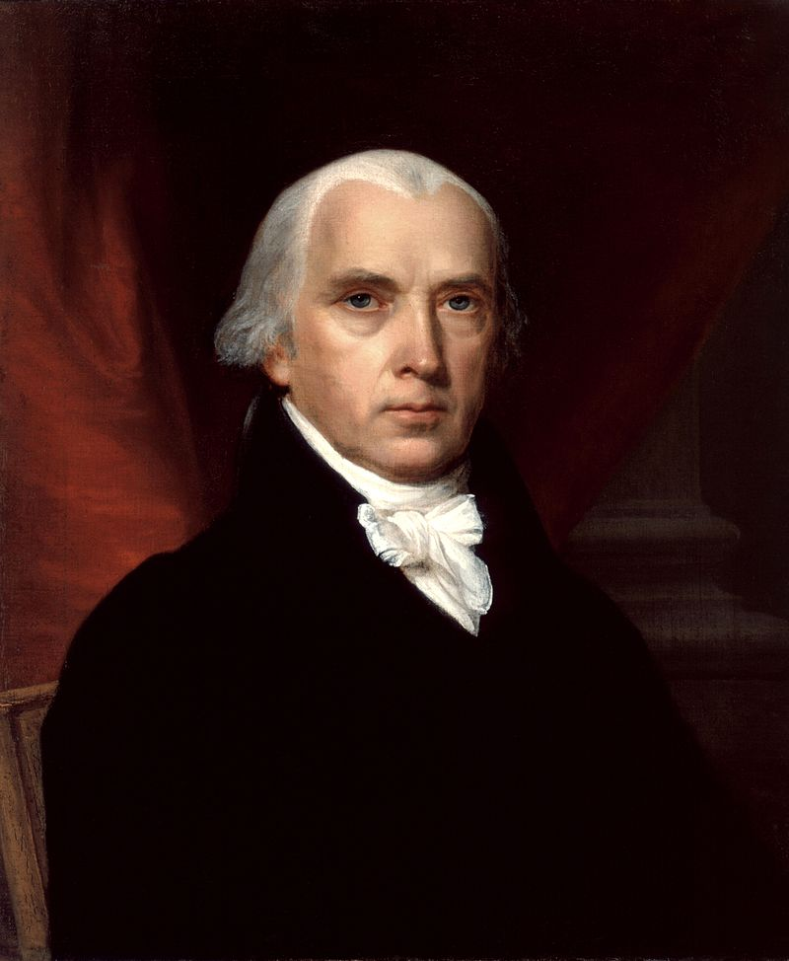
James Madison
Madison studied law, politics, and is known as “the father of the Constitution.” His ideas helped answer this question.

Slide 18
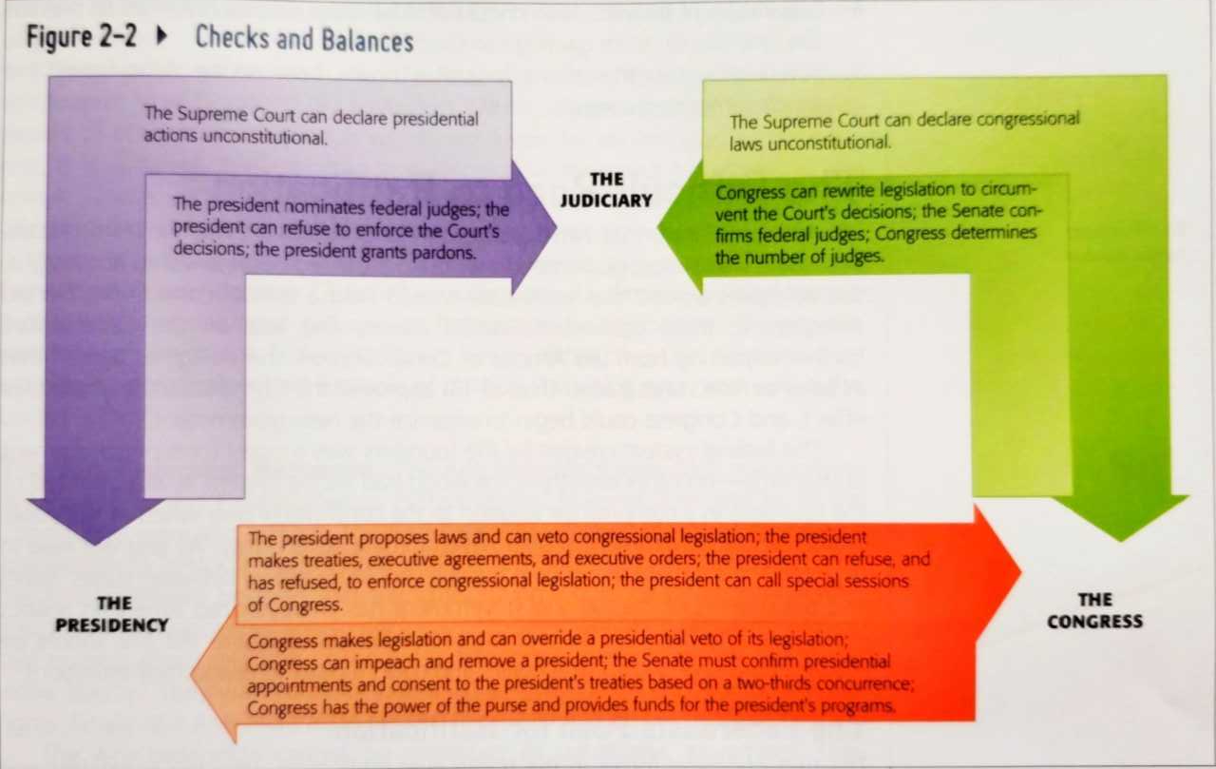
Madison’s Ideas
Limit majority control by putting most of the government out of reach.
Originally, only the House of Representatives was elected by the people. Senators were chosen by the state, and the president was chosen by electors.
Separating the powers of government.
Each branch of government was to be given its own tasks so that no one branch could have power over the others. However, powers are not divided absolutely.
Create checks and balances.
Because powers are not divided absolutely, each branch needs the others to perform certain tasks. This limits the government and prevents a majority from controlling the whole thing, creating checks and balances.

Slide 19
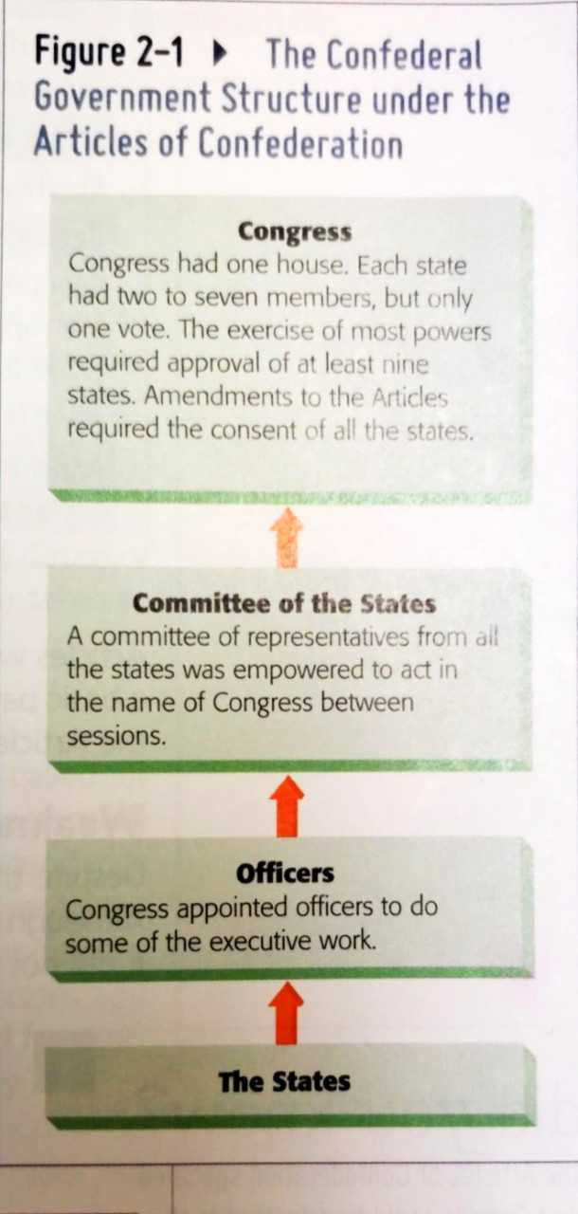
Madison’s Ideas
Madison’s ideas put in place a federal system of government where powers were divided and shared between a federal government and state governments (providing another example of checks and balances), effectively changing America’s system of government.
The Constitution also set up a republic, rather than a direct democracy because…
1. The writers of the Constitution did not want the people directly involved.
2. The United States already had a large population that would hinder direct democracy.

Slide 20
Systems of Government
Unitary: Power resides with the central government. It may create lower governments to carry out everyday tasks, but overall it tells the lower government what to do.
Confederate: A loose union of independent states that create a weak central government that can protect all members and solve major issues for all members.
Federal: Power is divided and shared between a central government and local governments. The central government creates lower governments that have powers of their own and powers that they share with the central government.
Notes:
Give examples and draw pictures.

Slide 21
Notes on Your Own
Using pages 51-58, answer the following questions to include in your notes for this chapter. It will be helpful to copy down the questions.
Explain the two major components of the Madisonian Model.
Compare both the Federalist and Anti-Federalist stances and Papers.
How many states had to ratify the Constitution? Why?
Create a thesis in response to Beard’s thesis.

Slide 22
The Final Compromise
In keeping with Madison’s idea of compromise, the Federalists promised to amend the Constitution to include a list of protected personal liberties.
They only promised to do this after ratification, meaning the Anti-Federalists had to act in good faith. They did, creating a third major compromise that helped put the Constitution together.
Madison kept the word of the Federalists by introducing 12 amendments in 1789.
Ten of these were approved and are attached to the Constitution as the Bill of Rights.

Slide 23
The US Constitution
The republic created by the US Constitution puts public opinion through filters before allowing it to reach the federal government.
However, it is a republic that also likes the status quo, meaning that a sizable majority is needed to create change.
Therefore agreement and compromise are encouraged before change.
But the federal system within the United States still works (for the most part) to prevent tyranny, listen to public opinion, and protect property rights and personal freedoms.

Slide 24
Important Clauses
The Commerce Clause (Art. I, S. 8, Cl. 3): “To regulate commerce with foreign nations, and among the several states, and with the Indian tribes.”
Gives Congress power over trade.

Slide 25
Important Clauses
The Elastic or “Necessary and Proper” Clause (Art. I, S. 8, Cl. 18): “To make all laws which shall be necessary and proper for carrying into execution the foregoing powers, and all other powers vested by this Constitution in the government of the United States, or in any department or office thereof.”
When deemed necessary, Congress can expand their power to get things done.
This was included because the writers of the Constitution wanted Congress to be able to act without being limited by the enumerated powers.
Ex: McCulloch v. Maryland

Slide 26
Important Clauses
Supremacy Clause: (Art. VI, Cl. 2): “This Constitution and the laws of the United States which shall be made in pursuance thereof; and all treaties made, or which shall be made, under the authority of the United States, shall be supreme law of the land; and the judges in every state shall be bound thereby, anything in the Constitution or laws of any state to the contrary not withstanding.”
Basically, the US Constitution is the be-all-end-all of legal documents in the US and the federal government is there to back it up.

Slide 27
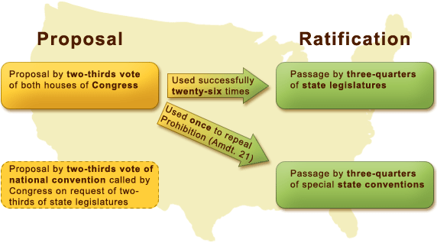
Amending the Constitution
Formal amendments are outlined in Article 5.

Slide 28
Amending the Constitution
Because formal amendments increase the ability of a popular majority to affect government, they make the Constitution more egalitarian and democratic.

Slide 29
Amending the Constitution
Informal changes to the Constitution happen through…
Judicial review: the right and ability of the judicial branch to determine constitutionality. This is a power that was created through a Supreme Court case (Marbury v. Madison). The Court’s interpretation can profoundly affect how the Constitution is understood.
Political practice: Things like the development of political parties, the reduction of the Electoral College have changed government without changing the Constitution.
Technology: The growth of communication technology specifically have added significance to or moved significance of branches and powers of government, as well as created questions and conversations.
Demands: These can shape policies and roles of different branches of government.

Slide 30
Constructionism
“The Constitution belongs to the living.” –TJ
Many see the Constitution as a flexible, living document. However some see it as rigid and not up for interpretation.
This is called constructionism.
Loose constructionism: the Constitution, through flexibility, can adapt and apply to modern situations, this allows future generations to determine/interpret the Constitution for themselves.
Strict constructionism: the Constitution says what it means and is not up for interpretation, things may be added or subtracted, but the actual language is not to be messed with.

