Slide 1
Chapter 25 America moves to the city
BY: Kaitlyn Yazzie, Zachery Wargo, Zackary Charlie, Nicholas Watson, Valdemar Poyer

Slide 2
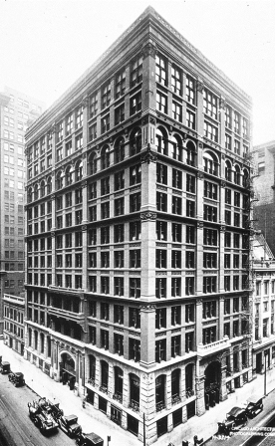
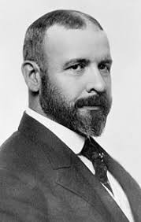
America moves to the city
Decades following the Civil War, America started moving to the city. By 1900, the US population nearly doubled from 40 million during the 1870 census, and the population in cities tripled during that time
This Phenomenon affected not only the United States, but most of the Western World, and caused an industrial and Urban Revolution.
The Urban Frontier
Many US metropolises during 1869 didn’t have more than a million people inhabited the area and by 1890 New York, Chicago and Philadelphia surpassed the million mark.
Cities grew both up and out, with the help of skyscrapers to pack more people and workspaces in a small piece of land.
Louis Sullivan (1856-1924) contributed in the further development of skyscrapers with his principle that “Form follows function”. During this time, Americans became commuters and used mass-transit lines from the suburban cities.

Slide 3
Continued…
Electric trolleys or “walking city” were compact and propelled city limits outward.
Electricity, indoor plumbing, and telephones caused major cities more alluring
Many department stores like Macy’s and Marshalls Field’s bloomed the middle class shopping, and provided many jobs mostly for women.
Transitioning from the Country dwelling lifestyle, most cities couldn’t keep us with the growth of the city population.
This caused crime to flourish and sanitary facilities to plumet
Impure water, uncollected garbage, unwashed bodies and animal droppings caused the city to develop a satanic stench and living conditions worsened, which led to the creation of slums
The New Immigration
With the cities growing, many immigrants came to the US mostly from Europe
During the 1850s to 70s, more than 2 million immigrants entered Americas shores
These “New Immigrants”, which many came from southern and Eastern Europe, had little history of democratic government and were largely illiterate
These people seeked for industrial jobs rather than working on the farm, and by the twentieth century, they made up a total of 66% of immigration inflow.

Slide 4
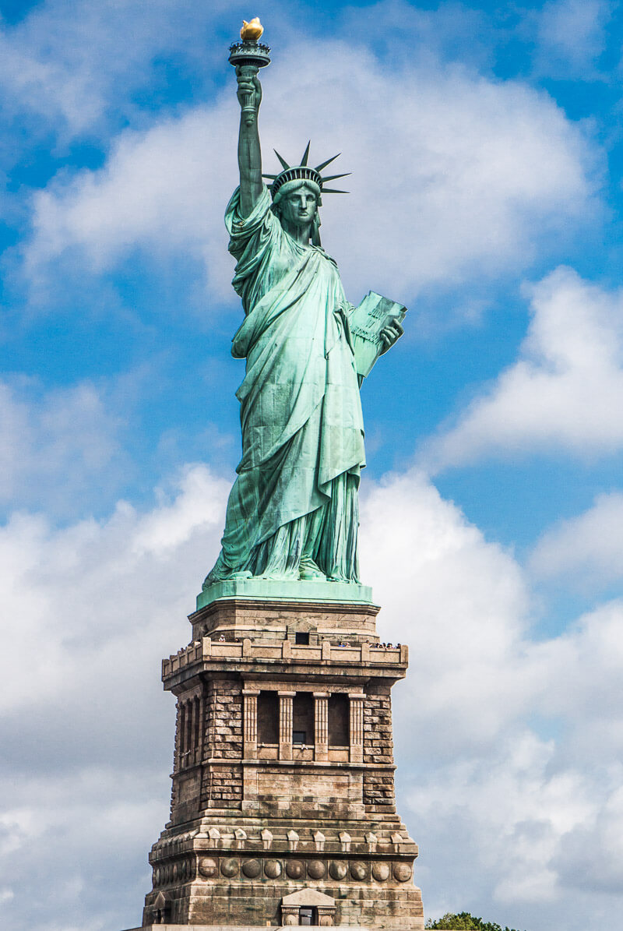
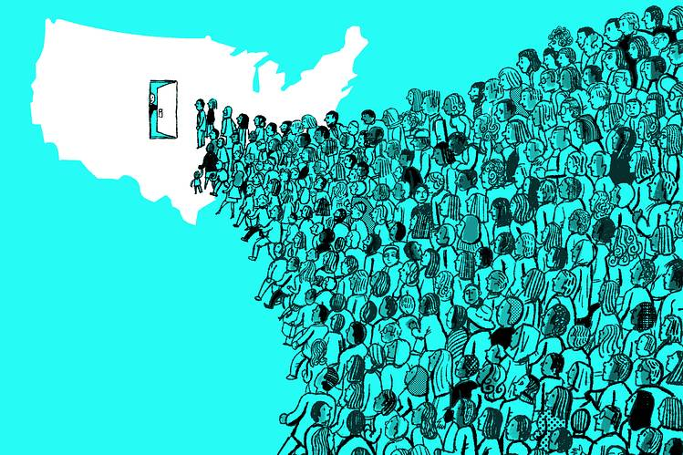
Immigration
Immigrants were coming to America, which meant that they needed jobs, as for the people who stayed behind they needed to preserve their traditional culture.
Anti-Foreignism was touched off by the Irish and German
armies in the 1840’s and 1850’s. As they came to escape
poverty and seek new opportunities in America.
Immigration caused Native-Born Americans to voice
fears at the country the government and other cities.
The statue of library was a gift from France as a
sentimental Birthday present to the American people.

Slide 5
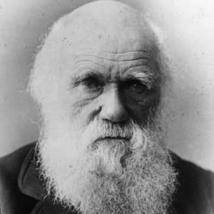
church
Literal protestants, roots from a brunch of protesters that flourished from 1875-1925, encouraged followers to use the bible as a moral compass rather than the truth.
Roman and catholic churches were gaining
new members to the immigration in the country.
Charles Darwin- a English naturalist that
believed in evolution, care of the first to do it
His belief wasn’t supported by many.

Slide 6
education
Schools were made to educate kids in fear of the m growing ignorant. Also it helped with child labor
High school education was needed for every citizen
Textbooks were provided more and more
Schools were doubled after the Civil War and in 1910, 300 schools were established in the US.
African American suffered education severely. As though they had people who taught them one thing or another. Such as Brooker T. Washington and George Washing Cavar.
Colleges and Universities were starting to change as well. Many colleges in the Midwest, started to close the gender gap in schools. As well as black institutions, and black colleges.

Slide 7
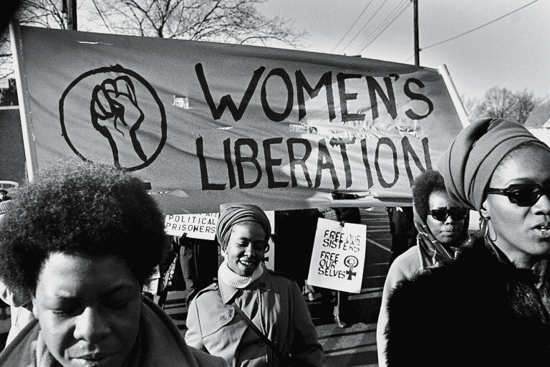
COntinued
Morril Act of 1862: Enlighted law that provided a generous grant to colleges to fund for establish of agricultural experiment.
New industrialization brought demand for “Practical” courses.
Books would amuse people of all ages. Book were popular and gave people ideas. Such as the newspaper to inform and magazines for good reading.
Although there were many authors, people still shunned black authors.
Woman authors were also a new thing as they used their power to show woman liberations.

Slide 8
Families
Families in the city were cracked from strain and were affected the most.
They would call this the “The Urban era of Divorce”. At this point many families were being broken a part. Divorce was becoming more and more common.
Surprising birth rates were decreasing, as parents would only use their kids as a way of work or for spending too much money.
National American women suffrage: Convention taking place in 1848 which helped organize owmen rights.
This soon led to the national Association of colored women in 1836.
Prohibiting alcohol and promoting reform

Slide 9
Parties
The national prohibition part, organized in 1869, polled a sprinkling amount of vote s in some of the ensuring presidential elections.
Militant women entered the alcoholic arena, notably the women’s Christian. Temperance union was organized in 1874.
Symbol of purity
Leading spirit
Lead by the sanity Frances E. Willard.

Slide 10
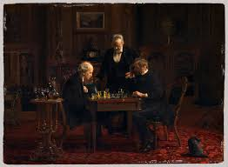
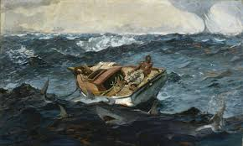
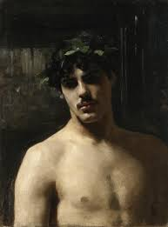
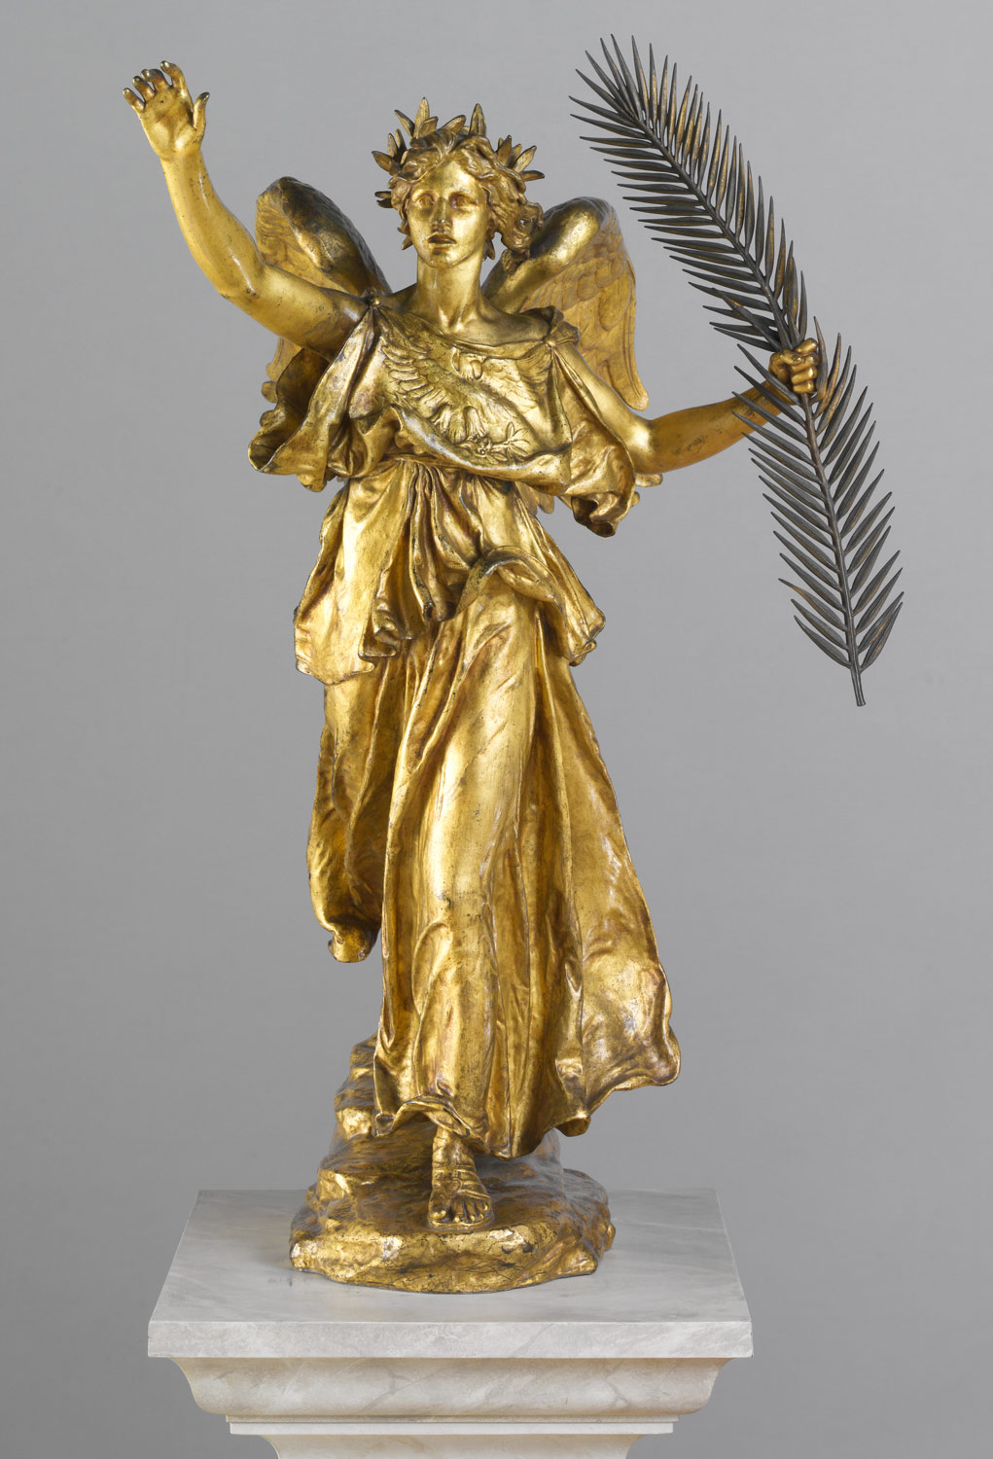
Artistic Triumphs
Art was becoming more and more popular.
Artist got recognized more for their work
Artists include:
Thomas Eatkins (1844-1916)
Winslow Homer (1836-1910)
John Singer Sargent (1856-1925)
Augustus Saint-Gaudens (1848-1907)
Some art inspired the way buildings were built.

Slide 11
The business of amusement
1865-1900: Cities were being built more rapidly.
Allowed for more time to relax and have fun.
Shows like circuses, acrobats, and singers, wild west salves.
Sports like baseball and basketball gained popularity.
Cities made Americans become diverse and similar.

