Slide 1
AP Government
Unit 1: Foundations of Government
Chapter 3 | 30 slides

Slide 2
Federalism
Federalism: system of government that organizes a nation so that two or more levels of government have authority over the same area.
Power is divided and shared: each level can do some of the same things, and each level has powers specific to that level.
Federalism is uncommon.

Slide 3
Other Systems
Most countries use the unitary system, which keeps power within the federal government.
Britain, France, China
Confederacies are also uncommon, and used to benefit multiple countries.
Examples: The EU, The Iroquois Confederation
The US began as a confederacy.

Slide 4
American Federalism: A Visual
Central Gov’t
The relationship between state and local governments is similar to the unitary system since local governments get their power from the state. State governments get their power from the Constitution.
Tribal Gov’t
State Gov’t
Tribal governments are considered “domestic dependent nations.” They are both outside and inside of American federalism.
Local Gov’t

Slide 5
Why Federalism?
Provides a means to ensure stability while empowering the states to govern in the areas closest to the everyday lives of their citizens.
Retained state traditions and local power while establishing a national government that could handle overarching problems.
Size and regional isolation.
Allows for political subcultures with a “variety of interests to influence government.”

Slide 6
Arguments Against Federalism
State and local interests may block progress on national plans.
Smaller political units are more likely to be dominated by a single interest or group, limiting minority rights.
Inequalities exist among states.
National powers can expand at the expense of the states.

Slide 7
Federalism and the Constitution
Federalism is not directly mentioned in the Constitution, but its attributes are.
This is shown through the different types of powers within the Constitution and their distribution.
These powers can be classified as belonging to the national government, the states, or prohibited to both.

Slide 8
Federalism and the Constitution
The Constitution also makes it clears that while federalism creates different levels of government, there is still a hierarchy.
The Supremacy Clause (Art. 6): federal law takes precedent over state laws, states cannot make and/or enforce laws that work against the Constitution or federal law.

Slide 9
Federalism and the Constitution
This does not mean that the federal government can usurp state power.
The Tenth Amendment: “The powers not delegated to the United States by the Constitution, nor prohibited by it to the States, are reserved to the States respectively, or to the people.”
US v. Darby (1941): The Supreme Court ruled that the 10th Amendment is a “constitutional truism, [that is] a mere assertion that the states have independent powers of their own, not a declaration that states powers are superior.”

Slide 10
Relation between State & National Powers
Four key events have settled the issue of how state and national powers are related:
Implied powers
Commerce power
The US Civil War
Racial equality

Slide 11
Relation between State & National Powers
There are five types of powers within the Constitution.
National Government
Express: expressly, or directly, stated within the US Constitution
Implied: not directly stated, but expressly defined
Inherent: things a government must do because it’s the government
State Governments
Reserved: anything not delegated to the federal government nor prohibited by the US Constitution
Concurrent: powers that belong to multiple governmental levels

Slide 12
Relation between State & National Powers
The elaboration of implied powers has created a distinct separation between the powers of state governments and the national government.
It has also limited a state’s reserved powers.
The best example of the federal government’s implied powers is seen the case of McCulloch v. Maryland (1819).

Slide 13
McCulloch v. Maryland set forth TWO Constitutional principles:
1. Supremacy of the Federal Government: Certain national policies may preempt state and local ones because the national government, “though limited in its power, is supreme within its sphere of action,” which includes all the states.
2. Implied Powers Exist: Implied powers exist alongside enumerated powers and the federal government has both. The most important implied power is the “necessary and proper” or elastic clause, which gives specifically Congress the power to act outside of its enumerated powers as long as its actions are still in line with the Constitution.

Slide 14
Relation between State & National Powers
The commerce clause gives Congress power over trade.
This was expanded in the Supreme Court case of Gibbons v. Ogden (1824).
The case created a broad definition of commerce to include almost every form of commercial activity.
This means that Congress regulate and control plenty of commercial activity: movement of goods, radio signals, telephone messages, the Internet, insurance transactions, and more.
Congress may also use this power to promote economic development.

Slide 15
Gibbons v. Ogden extended Congress’ power over trade and general commerce to the point where it covered most interstate and foreign trade.
The challenge to where Congress could control trade failed; the Court ruled that this was not a concurrent power.
It did not give Congress power over local transactions

Slide 16
Relation between State & National Powers
The US Civil war settled who had supreme authority militarily.
The struggle for racial equality settled who had supreme authority in terms of policy.
All of these events prove the relationship between state and national powers rests in the supremacy of the federal government. Their relationship is easily defined as “the federal government enacts policy as the superior government and the state implement it as the lower governments.”

Slide 17
State Powers
Police power: the authority to legislate for the protection of health, morals, safety, and welfare of the people.
Allows for laws on crimes, marriage, contracts, education, transportation, and land use.
Concurrent Powers: powers shared by the state and national governments.
Taxation, establish courts, charter banks and other institutions, and to a lesser extent police power.

Slide 18
State Obligations
“Full faith and credit”: States must recognize the legal documents and actions of another state.
Extradition
Privileges and Immunities: Citizens of each state will have receive the privileges of citizens in every state.
Exceptions: tuition, voting

Slide 19
Checks and Balances
Horizontal control: when branches of government on the same level check each other against the expansion of power.
Vertical control: a structural check against the accumulation of power in any one level.

Slide 20
Changes to Federalism
Over time, TWO major changes have occurred to the institution of federalism.
1. A shift from dual federalism to cooperative federalism.
2. The rise of fiscal federalism.

Slide 21
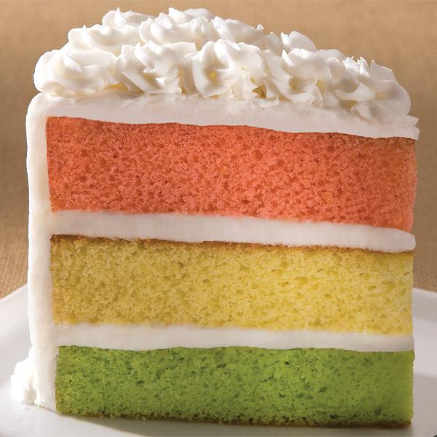
Changes to Federalism
There are two types of federalism
Dual federalism: each level remains supreme within its own sphere. Each is responsible for certain tasks which are distinct from each other, “like a layer cake.”
Cooperative federalism: each level shares powers and responsibilities while able to do some things on their own, “like a marble cake.”

Slide 22
In the beginning, there was more dual federalism, creating a “neat separation [of] purely state and purely national responsibilities.
However, the federal government has inserted itself into other areas, creating federal-state projects, and leading to a shift in responsibilities.
Ex: highways, schools.
This is also a shift toward cooperative federalism.
Notes:
Think of the federal government here as a parent or sibling helping a younger child. The federal government began to get involved so things could get done faster, or because the states needed help with things. Because they are working together more frequently, this creates the shift toward cooperative federalism.

Slide 23
This has also created some standard procedures in programs and projects:
Shared costs: cities/states may receive federal money for certain projects if they agree to pay for part of it as well.
Ex: The federal government will match funding for a state project.
Federal guidelines: the federal government may attach certain guidelines or regulations to money, final products, or both.
Ex: The federal government may require a state project to meet certain requirements before its finished or can receive federal funding.
Shared administration: state/local governments must implement certain policies set forth by the federal government but also have their administrative powers.
Ex: A state can receive federal funds for job training, but the state decides what kind of training it is spent on.

Slide 24
Cooperative federalism has take a firm hold in government.
So much so that it is maintained even when levels are upset at each other.
It has also, however, led to a call for devolution of power.
Devolution of power was first called for by Republicans, who wanted to make this shift go the other way—giving states more responsibilities. They have since backtracked, relying on the power of the federal government to achieve party policies.

Slide 25
Decentralization
The process of dispersing powers and functions of government.
Federalism decentralizes both politics and policies.

Slide 26
Decentralizing politics
More layers of government creates more opportunities for political participation.
By decentralizing politics, federalism promotes
Political participation
Judicial power
Fewer issues of interest at a national level
Because more people can participate at lower levels of government and test policies through the judicial system, a filter is created for national issues, allowing only key problems or concerns through to the national government.

Slide 27
Decentralizing Policy
By creating divided and shared powers, there are fewer discussions about who should solve what issues.
States may act as a “testing ground” for policies. Results or complications can be observed by other states and/or the federal government.
Ex: Legalization of marijuana.
Policies “are subject to both the centralizing force of the national government and the dispersing force of the states,” meaning that the states help the federal government implement and enforce policies.
Ex: Federal government requires states to enforce to age restrictions on buying and consuming alcohol.

Slide 28
Fiscal Federalism
Fiscal federalism: the pattern of spending, taxing, and providing grants in the federal system.
“The cornerstone of the federal government’s relationship with state and local governments.”
It creates a trade off in influence: whereas states elect national representatives, the national government can give the states money.
Grants-in-aid: federal funding set aside by Congress for state and local governments; the main thing the federal government uses to aid and influence.

Slide 29
Notes on Your Own
Using pages 90-92, answer the following questions to include in your notes for this chapter. It will be helpful to copy down the questions.
Let’s talk about grants.
Explain each type of grant. What are they called? How are they used?
How are strings attached to a grant? Why does this happen?
Provide an example of each type of grant in action.
What is a mandate? How are these different from grant “strings”?
How does federal funding exhibit (or not, your call)…
Dual Federalism?
Cooperative Federalism?
Fiscal Federalism?

Slide 30
Notes on Your Own
Using pages 94-99, answer the following questions to include in your notes for this chapter. It will be helpful to copy down the questions.
Why would states prefer the status quo?
Create a thesis statement that either supports or opposes devolution/decentralization.
How relevant is the political cartoon on page 95 in describing federalism overall or a specific type of federalism?
What is New Judicial Federalism? Why is it being used?
Summarize ONE case from each section and its relation to federalism.
Commerce Power
11th Amendment
10th Amendment
Other

