Slide 1
AP Government
Unit 2: Rights and Liberties
Chapter 4 | 16 slides

Slide 2
Civil Liberties
Express limits on the government’s ability to interfere in individual lives and the exercise of popular sovereignty.
The Bill of Rights attached to the US applies to the national government, while state constitutions have since included bills of rights on their own.
It wasn’t until the Reconstruction Amendments that both the national and state governments would be limited in this way together.
Incorporation Theory: the idea that most of the protections under the Bill of Rights apply to state governments through the 14th Amendments due process clause.

Slide 3
Freedom of Religion
Establishment Clause (1st A.): prohibits the establishment of a church supported by the national government
Creates separation between church and state.
“Neither a state nor the federal government can set up a church. Neither can pass laws which aid one religion, aid all religions, or prefer one religion over another.” (Emerson v. Board, 1947)
Because the government can neither promote nor discriminate against religion, complex Constitutional questions have arisen at both the state and national levels about the role of religion in schools and school funding, display of the Ten Commandments, the teaching of evolution, religious speech, and religious expression.

Slide 4
The Lemon Test is often used to determine constitutionality of legislation with the Establishment Clause in mind.
Does the statute have a distinct secular purpose?
Does the primary effect of the law advance or inhibit religion?
Does the law result in excessive government entanglement with religion in respect to the institution benefitting, the nature of aid provided, and/or the resulting relationship.
Engel v. Vitale (1962)

Slide 5
Freedom of Religion
Free Exercise Clause (1st A.): no type of religious practice can be prohibited or restricted by the government.
Religious Freedom Restoration Act (1993): required the national, state, and local governments to “accommodate religious conduct” unless the government could demonstrate a compelling reason not to.
States have since adopted more localized versions of this law, which nationally has been reduced to say that if the government must regulate a religious practice, it must do so using the least restrictive way.

Slide 6
Freedom of Expression
Interpreted to include freedom of speech and freedom of the press.
Prior restraint: restraining an action before it has occurred, can be seen as censorship when expression is involved.
Can be simple: getting a permit before a performance, having an article edited, etc.
Often used to censor the press, it is the government’s job to show justification in larger cases.

Slide 7
Symbolic speech: nonverbal expression of beliefs which is generally given substantial protection by the courts.
Commercial speech: advertising statements.
“Advertising…is nonetheless dissemination of information as to who is producing and selling what product for what reason and what price.”
Ads making false claims can be restricted, and how certain ads are distributed may be regulated.

Slide 8
Restrictions on Expression
“Clear and Present Danger”: expression may be restricted if evidence exists that it would cause “a condition, actual or imminent” that Congress could prevent, disrupting public safety and order.
Unprotected Speech
Obscenity: though restricted, there are definitional problems.
Slander: the public uttering of a false statement that harms another’s reputation.
Defamation of character: wrongfully hurting a person’s good reputation.

Slide 9
Freedom of the Press
Originally intended for newspapers, pamphlets, magazines, and books, it has grown to include other sources of news and printing, denoting a “special instance of free speech.”
There are still discrepancies over what can and cannot, or should and should not, be printed.

Slide 10
Restrictions on the Press
Libel: a written defamation of a person’s character, reputation, business, or property; like slander only written.
Actual malice: knowledge of and disregard for the falseness of a statement with full intent to harm.
Because of their access to public mediums, public figures must prove actual malice in defamation cases.
Gag Orders: an order written by a judge restricting the publication of news about a trial to protect the right to a fair trial.
Films and online video outlets mainly censor themselves. Music and TV have the least protection.
Federal Communications Commission (FCC): governmental agency that regulates public airwaves/frequencies which can impose sanctions regarding obscenity and unprotected speech.

Slide 11
Assembly and Petition
Protection for the “ability of private citizens to communicate their ideas on public issues [and] join interest groups and lobby the government.”

Slide 12
Privacy
While never directly mentioned in any one amendment, the right to privacy can be seen as implied by several (namely Amendments 4 and 9).
Some of the issues surrounding and individual’s right to privacy include: information privacy, abortion, “right to die”/assisted suicide, and security issues like the Patriot Act, wire taps, and release of data such as internet searches, phone logs, and GPS data.

Slide 13
Rights of the Accused
Include Amendments 4 through 8.
All citizens, criminal suspects or otherwise, have the right to due process of law and fair treatment.
Due process of law: things cannot be taken away from you without a legal process.

Slide 14
Rights of the Accused
Updates to these rights:
1910s: Exclusionary rule—policy that forbids the admission of illegally obtained evidence at trial. (tested Mapp v. Ohio, 1961)
1940s: only criminal defendants in a capital (death penalty) case automatically had the right to counsel. (Betts v. Brady)
1963: if anyone accused of a felony cannot afford a lawyer, one will be provided at government expense. (Gideon v. Wainwright)
1966: suspects in all criminal investigations must be informed of their rights at the time of arrest. (Miranda v. Arizona)
Exceptions: public-safety exception, express conduct—suspects must directly state their want of counsel and/or to remain silent.

Slide 15
“Cruel and Unusual Punishment”
Capital punishment is still widely debated in the US.
The Supreme Court asked states to make their laws concerning the application of the death penalty more precise in order to be consistent instead of simply letting juries decide.
Bifurcated procedure: upheld by the Supreme Court, it creates a two-step process for putting the death penalty in place.
First, “a jury determines the guilt or innocence of the defendant for a crime that has been determined by statute to be punishable by death.”
Second, if the defendant is found guilty the jury will reconvene to consider all relevant evidence to determine if the death penalty is warranted.

Slide 16
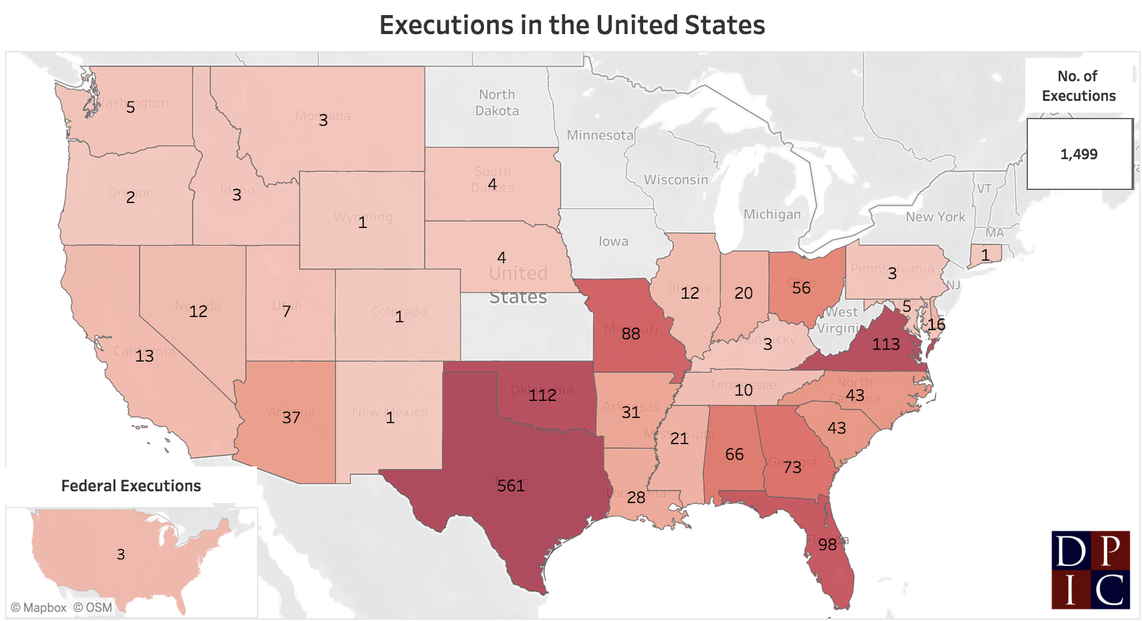
“Thirty-two states, the military, and the federal government have capital punishment laws” using the bifurcated procedure.
State governments are generally responsible for executions.
The US government has held three executions since 1961, while the US military has not held an execution since 1961.

