Slide 1
AP Government
Unit 3: People and Politics
Chapter 9 | 32 slides
But there are like, three videos and lots of maps okay?

Slide 2
Candidates
Candidates are divided into two groups: self-starters and the recruited.
Self-starters get involved in politics to further their careers, carry out specific programs, or in response to issues/events.
Recruiting candidates is easier for some offices than others.
A third-party candidate will run knowing full well they won’t win, but will gain publicity for their views.
While issues are important personal goals are a central motivator.

Slide 3
The Nomination Process
Generally controlled by state laws that favor the two major parties.
The first step is often filing a petition and gathering signatures, and paying a fee.
For some higher offices, a candidate may need to be formally nominated a state convention.
This may include a primary election, in which multiple candidates vie for their party’s nomination.

Slide 4
Eligibility
All must be elected to office.
Executive Branch
Legislative
President
Natural-born citizen
14 year resident
35 years old
Vice President
Same as President
Senator
30 years old
9 year citizen
From state they represent
Representative
25 years old
7 year citizen
From district they represent

Slide 5
Candidate Diversity
The passage of civil rights legislation in the 1960s made it a possibility for more minority candidates to run and actually get elected.
By 2013, an estimated over 10K African-Americans had been elected, including president at the time, Barack Obama.
In 2014, 182 women ran for positions in Congress; 256 ran in 2018, representing an almost 150% increase.
The 2018 midterm elections also created the most diverse Congress to date, including the first all-minority delegation (NM), the first Muslim representatives, the first female Native American representatives, the youngest representative, and many historic state firsts including the first Native American governor, the first openly-gay governor, and more.

Slide 6
Campaigns
Campaigns require strong organization, expertise in polling and marketing, extended use of technology, and lots and lots of money.
The goal is always the same though; convincing voters to choose your candidate.
Party-centered vs. candidate-centered campaigns: parties having the most influence (you’re voting for them because they belong to x party) as opposed to candidates having the most influence (you’re voting for them because of this more superficial reason).
It is more beneficial today to run a candidate-centered campaigns as less of the population identifies with one particular party.
This means that a candidate must “provide a persuasive cases for [their] election to party identifiers and to the growing class of independent voters.”

Slide 7
Campaigns
Most campaigns use a professional staff.
Political consultant: hired to devise campaign strategy and manage the campaign overall.
Finance Chair: directs fundraising and campaign spending, oversees compliance with campaign finance laws and reporting requirements.
Pollster: the person or firm who conducts public opinion polls for the campaign.
Communications director: plans the communication strategy and advertising campaign for the candidate.
Press Secretary: individual who interacts with the journalists covering the campaign.

Slide 8
The Strategy of Winning
Because the US uses a plurality voting system where the runner-up gets nothing, campaigns focus on their visibility, message, and overall strategy to make sure they have the highest possible chance of winning.
Visibility: how well known the candidate is, name/face recognition.
Tracking polls: a poll taken for the candidate on a nearly daily basis as Election Day approaches.
Focus Group: small group who are led in discussion by a consultant in order to gather opinions and responses to candidates and issues.
The goal of the media/ad strategy of the campaign is for the public to “accept and support the image of the candidate created by the campaign.”

Slide 9
Financing
A multitude of laws now restricts campaign financing and spending.
Corrupt practices acts: series of laws passed by Congress in attempt to limit and regulate the size and sources of contributions and expenditures in political campaigns.
Hatch Act (1939): restricted the political activities of gov’t employees, and prohibited political groups from spending more $3M on campaigns and limited individual contributions to political groups to $5K.
Federal Election Campaign Act (1971): replaced all past campaign finance laws, no limit on overall spending but on areas in which it could be spent, personal contributions, individual and group contributions, and created public funding.

Slide 10
Notes on Your Own
Using pages 312-313, answer the following questions to include in your notes for this chapter. It will be helpful to copy down the questions.
What principles have guided campaign finance legislation since the 1970s?
What further reforms did Congress make in 1974? What prompted these additional reforms?
What is “hard money”?
What was the precedent set by Buckley v. Valeo?
How is public money for campaigns generally acquired?

Slide 11
Reaction
Obviously, people will work to get around these new regulations or find loop holes.
Interest groups and corporations give money to candidates or support their campaigns through:
Political Action Committees (PACs): committee set by and representing a corporation, union, or interest group that raises money in order to make donations to campaigns.
Issue Advocacy Advertising: ads paid for by an interest group that support or oppose a candidate and/or their position on an issue without mentioning voting or elections.
Soft money: the funds of a political party which are unregulated by state and federal laws for general party activities and campaign donations.
Super PACs: a PAC that can accept unlimited contributions from individuals and corporations to spend supporting a candidate as long as its efforts are not coordinated with the campaign.

Slide 14
The Presidential Campaign
Steps in the Process
(Presidential) Primary Elections
National Convention
General Election
The Popular Vote
The Electoral Vote

Slide 15
Types of Primary Elections
Open Primary: voters can vote in a private voting booth in either party primary without disclosing their party affiliation
Closed Primary: voters can vote in a private voting booth choosing from only that party’s candidates after declaring their party affiliation
Caucus: small local meeting of party members designed to select candidates
Blanket Primary: voters can vote for candidates of more than one party—the general public can vote for any candidate in any primary
Runoff Primary: when the top two candidates compete against each other after no candidate receives a formal majority in the initial primary

Slide 16
Presidential Primary Elections
Statewide primary election of delegates to a political party’s national convention, held to determine a party’s presidential nominee.
January-June of an election year.
Serves to choose a state’s delegates to the national convention.
Narrows down the field of potential presidential candidates for each party, while giving the public general control of the nomination process.
“Beauty Contest” Primaries: presidential primary in which potential presidential candidates compete for popular votes but the results of which do not determine the state’s selection of delegates.

Slide 17
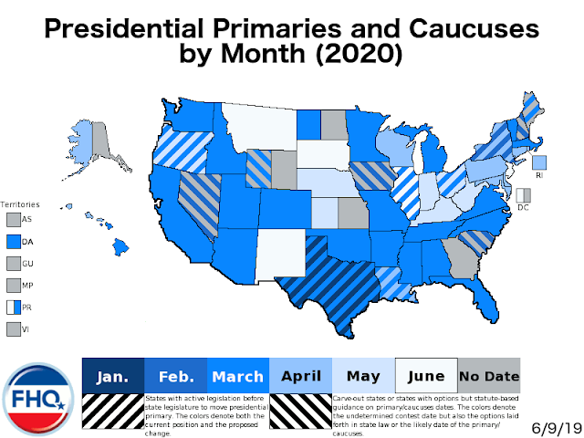

Slide 18
Presidential Primary Elections
Super delegates: a party leader or elected official who is given the right to vote at the party’s national convention and are not elected at the state level; created after weaker candidates were chosen as a special privilege to the party’s elected officials.
Front-runner: the presidential candidate who appears to be ahead at a given time during primary season.
Front-loading: the practice of moving presidential primaries forward to maximize impact and attention.
Super Tuesday: The Tuesday in March when a large number of states will hold their presidential primaries.

Slide 19
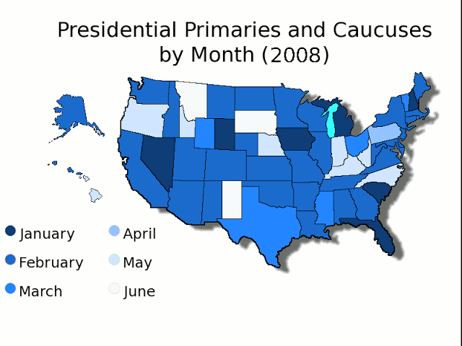
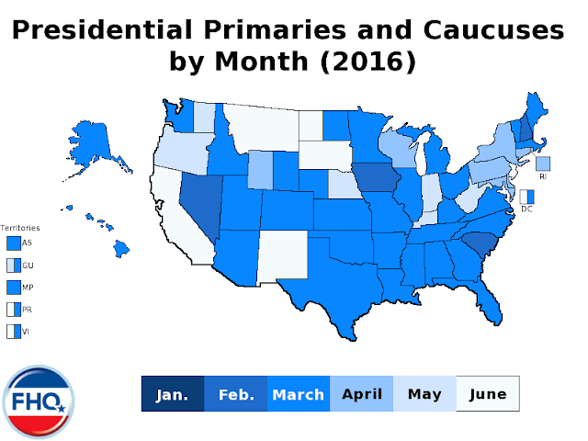
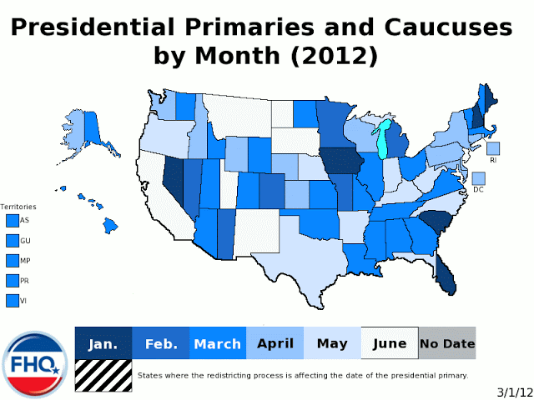

Slide 20
National Conventions
Typically 3-4 days with little to no media attention or drama.
Day 1: Speeches
Day 2: Committee reports & party platform
Day 3: Presidential ballots
Day 4: Candidate acceptance speech & VP

Slide 21
Elections
All federal elections are held on the first Tuesday after the first Monday in November as per the Constitution.
All states hold their elections on the same day, even when there are no federal candidates.
Special election: election to fill a vacancy
Recall election: election to remove a previously elected official

Slide 22
Elections
Ballots
Australian (Secret) Ballot: a secret ballot prepared, distributed, and counted by government officials at public expense.
Office-Block (Massachusetts) Ballot: general-election ballot in which candidates for elective office are grouped together under the title of the office; puts office/candidate above party.
Party-Column (Indiana) Ballot: general-election ballot in which all of a party’s candidates for elective office are arranged in one column under the party’s label & symbol; puts party above office/candidate.
Fraud & Mistakes
Often suspected, rarely proved.
Mistakes are few, but rarely result in what is described as “fraud”; it is usually the act of enterprising politically-minded individuals that cause voter fraud.

Slide 23
Election Reform
Help America Vote Act (2002)
Established the US Election Assistance Commission
Set standards for voting machines
Distribute funds to help communities obtain new, easier-to-us machines.
Most voting machines keep records digitally, making them subject to fraud, so both paper and digital records are counted against each other.

Slide 24
The General Election
In the presidential election, the popular vote happens first.
Swing States: states whose votes often shift from one party to the other and/or generally increase or decrease every election year
Battleground states: a state likely to be so closely fought that the campaigns devote extra effort to winning the popular and electoral vote there.
Link

Slide 25
Voting in the US
Voters can vote for more than one thing on a ballot, this includes the presidential ballot.
Voter turnout: the percentage of citizens taking part in the election process; the number of eligible voters who actually show up on election day to cast their ballots.
Voter turnout is generally low in the US, and has hovered between 50 and 60% for the last two decades.
The general cause for this has been decided to be voter apathy or cynicism, but may also be bad measurements.
Rational Ignorance Effect: when people purposely and rationally decide not to become informed on an issue because they believe their vote is not likely to make a difference showing a lack of incentive to seek the necessary information to cast an intelligent ballot.

Slide 26
Notes on Your Own
Using pages 325-334, answer the following questions to include in your notes for this chapter. It will be helpful to copy down the questions.
How does low voter turnout represent a threat to democracy?
How does low voter turnout simulate the free rider effect?
What are the factors that influence who votes?
How do each of the following influence people not to vote?
Uninformative media coverage
Negative campaigning
Negative voter efficacy
Describe THREE historical restrictions to voter eligibility and how they have since been eliminated.

Slide 27
The General Election
After the popular vote, the electoral vote is cast.
When people vote for president they are telling an elector from that party how to vote.
There are 538 electors in the Electoral College.
A state’s electoral vote is equal to its congressional representation.
This vote happens in December.
While most electoral votes follow the popular vote, only 29 states have laws making sure of it.
Faithless elector: an elector that does not vote for the presidential and/or vice presidential candidate they pledged to vote for.

Slide 28
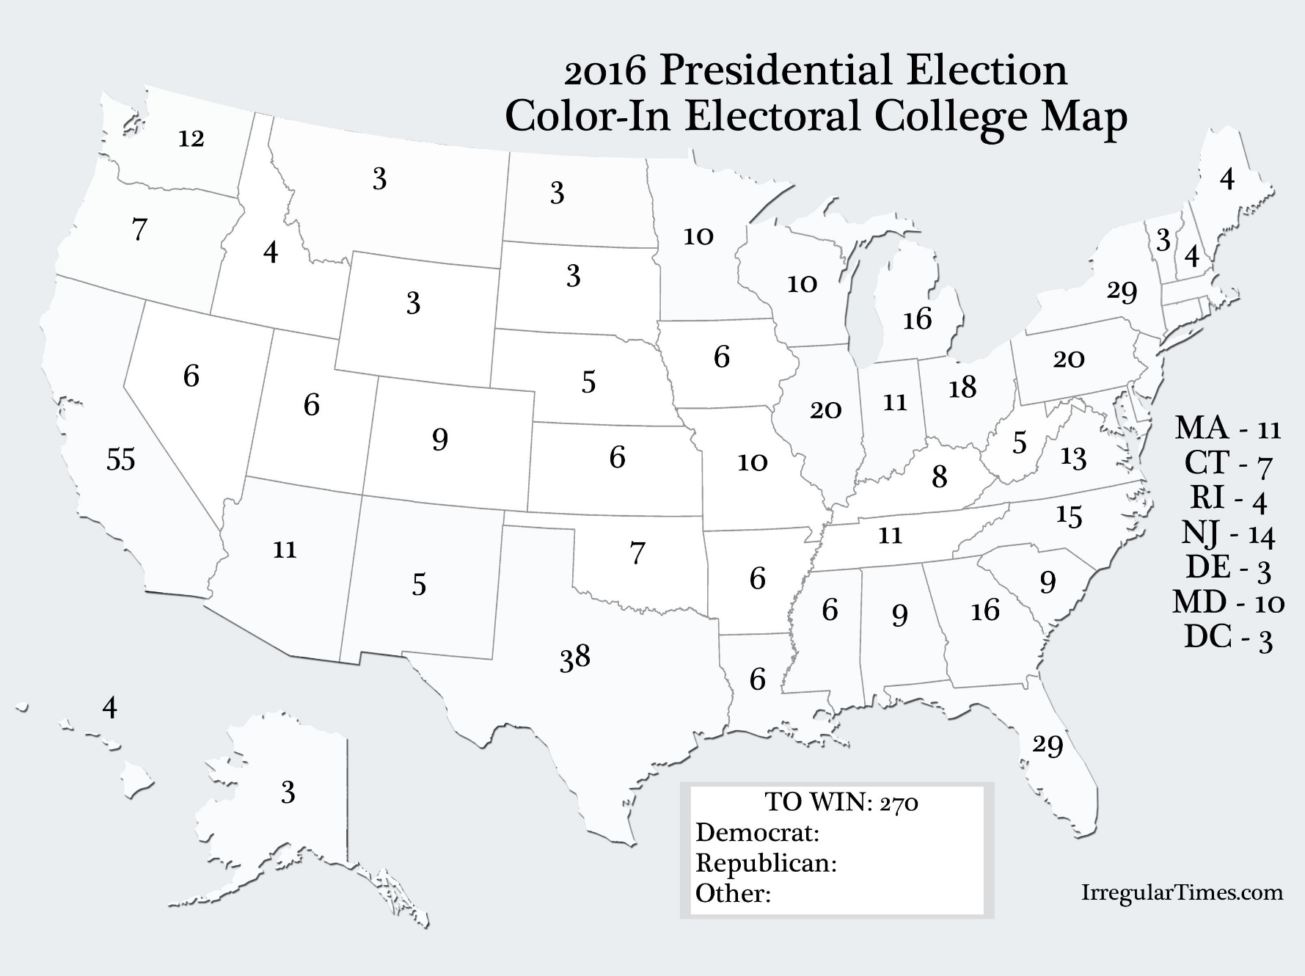
Th Electoral College

Slide 29
12th Amendment in Action
“While Federal law does not govern the general appearance of the Certificates, they must contain two distinct lists—one for President and one for Vice President.”
New Mexico’s 2016 Electoral Ballot
One “ballot” for president
One “ballot” for VP
State seal
Electors’ signatures
State official’s signature
Link

Slide 30
Criticisms of the Electoral College
Originally put in place by the writers of the Constitution to keep the election of president and vice president indirectly out of the hands of the “excitable masses”.
A candidate can lose the popular vote and still win the electoral vote.
It’s a winner-take-all system (except for ME and NE).
Favors states with smaller populations.
Attention of media and candidates is often focused on battleground states.

Slide 31
The General Election
Once the popular and electoral votes have been cast, everything is sent to Congress.
Congress will usually open its session with the formal counting of the votes.
If no candidate receives a majority of the electoral vote, the election will be pushed to the House of Representatives who will choose from the top three.
Each STATE will vote, resulting in a max of 50 votes, based on plurality among the representatives.
This has happened twice.

Slide 32
The Whole Process

